Slide 1
APOLOGETICS
IN ONE LESSON
almost
Ai1L.net
Lesson 23
Has the Bible been mistranslated?

Slide 2
What Bible translation do you usually use and why do you use this translation?
1

Slide 3
What questions do you have about Bible translations?
2

Slide 4
Summarize the critics' viewpoint such that they would say “that’s right”
3

Slide 5
List out the individual claims that the person is making
4

Slide 6
What questions would you ask this person?
5

Slide 7
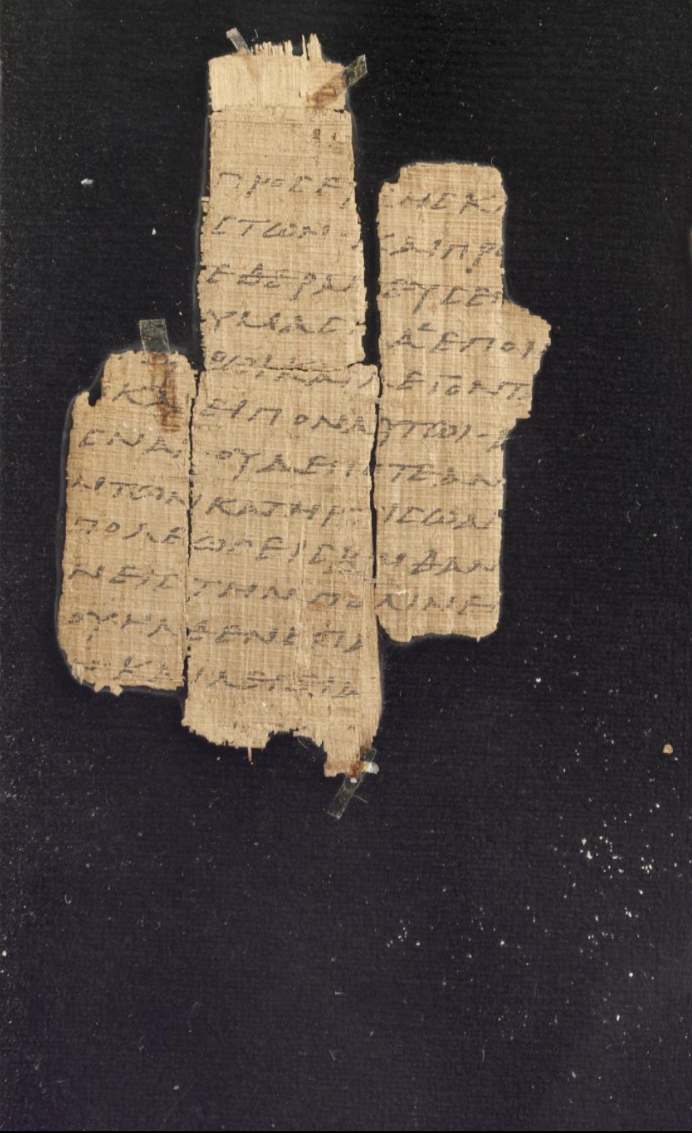
Papyrus 45 (𝔓⁴⁵) containing Matthew 21:13. Currently in Dublin, Chester Beatty Library and Vienna, Austrian National Library.
CSNTM http://www.csntm.org/Manuscript/View/GA_P45

Slide 8
𝔓⁴⁵
Gospel according to Matthew
𝔓⁶⁴
UBS
ESV
𝔓⁷⁰
Greek
Compilation
Translation
Jesus
Apostles
Written
Gospel
Copies

